Slide 1
Getting Started
Dr. Noureddine Bekhouche
Dept. of Applied Engineering

Slide 2
Router Setup
Connect PC/Laptop’s Ethernet port to one of four, 4, ports (not Internet) on the router.
192.168.10.99

Slide 3
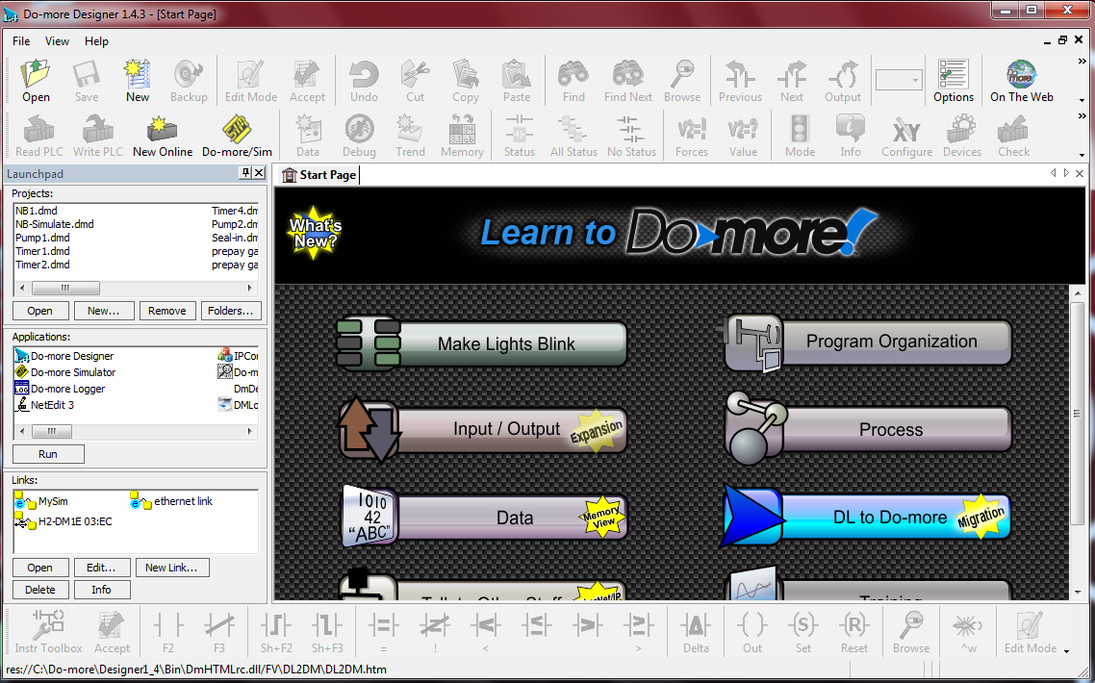
PLC-PC Link
Open the Do-more Designer program
Click on the NetEdit 3
NetEdit 3

Slide 4
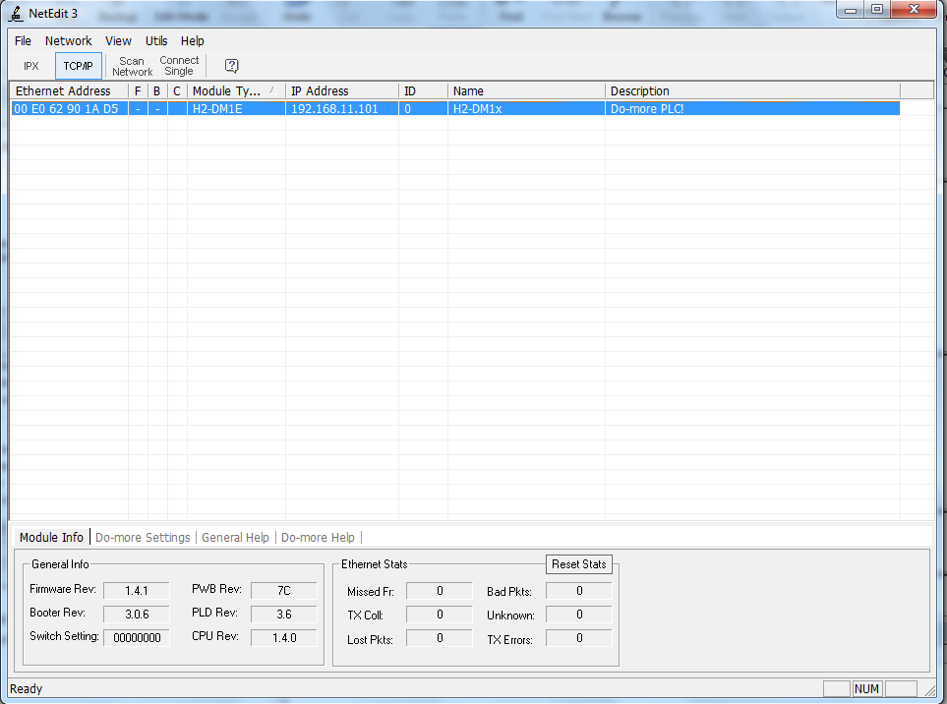
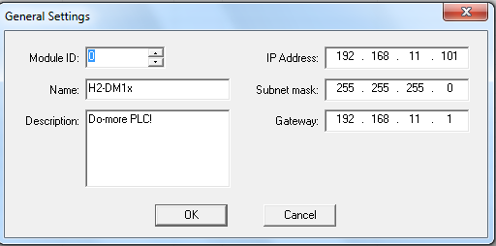
PLC-PC Link – Contd.
select TCP/IP tab and click on IP address tab
Enter the numbers below if different, click OK

